Slide 1




Dance and Fitness
ChaChaCha
Group 7

Slide 2

'Cha Cha Cha' or simply 'Cha Cha' is a Cuban dance introduced by Enrique Jorrin in the 1950's.
Enrique Jorrin - A cuban composer and violinist

Slide 3
The dance movement gained so much popularity that it eventually replaced the Mambo — where it came from.

Slide 4
There are two versions of the origin of the name Cha Cha;
First, to vocally mimic the shuffling sound of the dancer’s shoes when it hits the dance floor
The second version of the origin of the Cha Cha states that it hails from religious ritualistic dances from the West Indies. Historical studies show that Voodoo band leaders used small rattles created from Cha Cha plants to create a unique sound.

Slide 5
An english dance teacher, Pierre Lavelle, was also credited for importing the Cha Cha to the continent of Europe .
In 1953, Orquesta América (Jorrin's group) released two of Jorrin's compositions, "La Engañadora" and "Silver Star", on the Cuban record label Panart. These were the first cha-cha-cha compositions ever recorded.

Slide 6
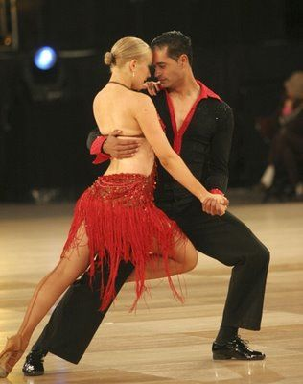

Characteristics
Cha-Cha-Cha
The cha-cha is a vibrant, flamboyant and playful dance. The light and bubbly feel of the cha-cha gives it a unique sense of fun.
The cha-cha requires small steps and lots of hip motion (Cuban motion), as it is danced in 4/4 time. The fourth beat is split into two, giving it the characteristic rhythm of 2, 3, 4 and 1. Therefore, five steps are danced to four beats. You may have heard it counted like, "One, two, cha-cha-cha."

Slide 7

ChaChaCha
Movement Skills

Slide 8

Movement Skills
Basic Cha-Cha Steps:
Cha cha music is composed in 4/4 time (four beats to a bar of music). For each bar of music there are 2 slow and 3 quick steps, which may be counted as – one, two, cha, cha, cha or step, step, step, quick step, quick step. The footwork is simple and mostly focuses on just shifting weight from one foot to another.

Slide 9
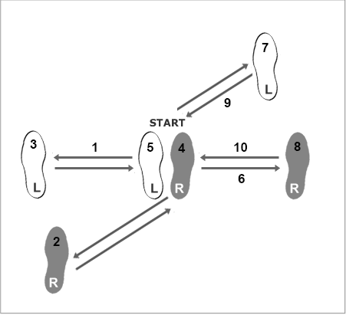
Basic Side Step for Men
Sidestep to the left with your left foot
Step backward & left with your right foot
Left foot in place, weight shifts to it
Sidestep to the right with your right foot
Move your left foot to your right foot
Sidestep to the right with your right foot
Step forward & right with your left foot
Right foot in place, weight shifts to it
Sidestep to the left with your left foot
Move your right foot to your left foot

Slide 10
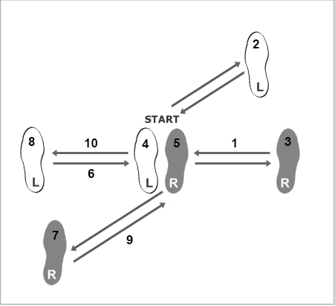
Basic Side Step for Women
Sidestep to the right with your right foot
Step forward & right with your left foot
Right foot in place, weight shifts to it
Sidestep to the left with your left foot
Move your right foot to your left foot
Sidestep to the right with your left foot
Step backward & left with your right foot
Left foot in place, weight shifts to it
Sidestep to the right with your right foot
Move your left foot to your right foot

Slide 11
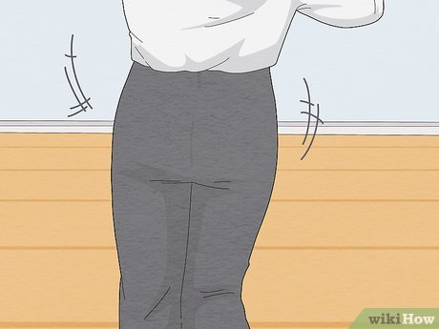
2. Hip Movement: The hip movement is a key element of the cha-cha. Dancers must master the technique of moving their hips in a fluid and rhythmic manner, which adds to the dance's distinctive Latin flavor.

Slide 12
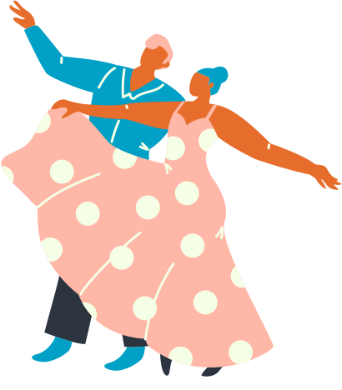
3. Partnering Skills: Cha-cha is often danced with a partner. Dancers need to develop skills in leading and following, maintaining proper connection, and coordinating movements with their partner.

Slide 13
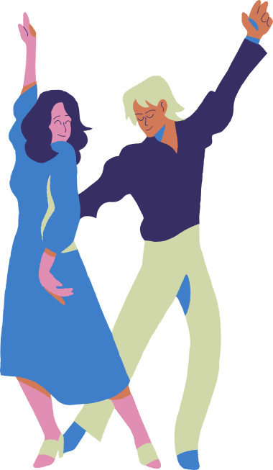
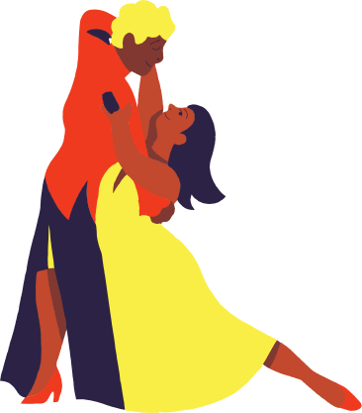
4. Styling: Styling involves adding personal flair and expression to the dance. This can include arm movements, spins, and body movements that enhance the overall performance.

Slide 14

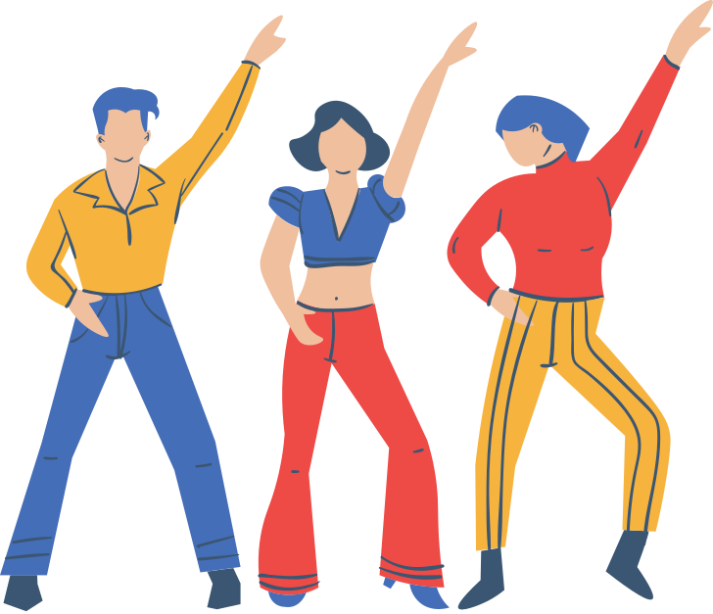
5. Rhythm and Musicality: Having a strong sense of rhythm and musicality is essential in cha-cha dancing. Dancers need to match their steps and movements to the rhythm and phrasing of the music.

Slide 15
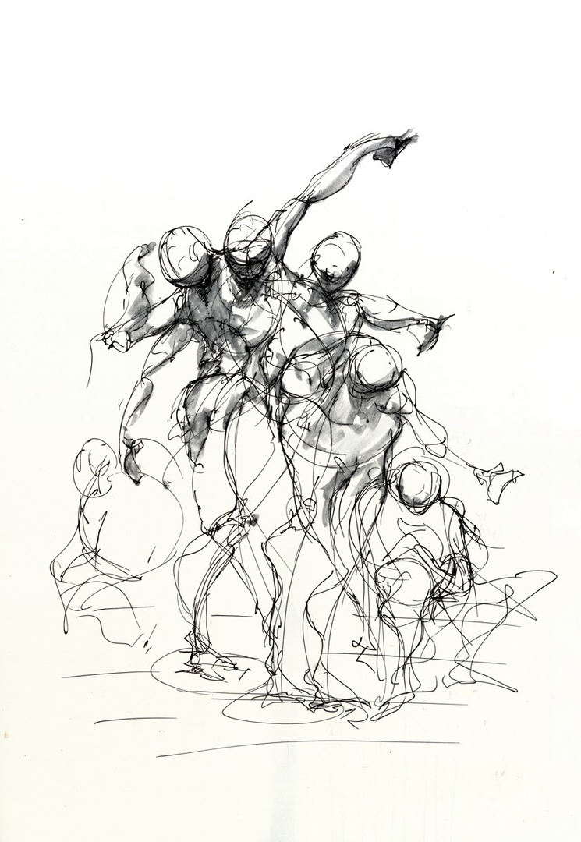
6. Transitions: Smooth transitions between different steps and movements are important for maintaining the flow and continuity of the dance.

Slide 16


Slide 17


FITNESS BENEFITS
FITNESS BENEFITS
Exercise strengthens your heart and improves your circulation. The increased blood flow raises the oxygen levels in your body. This helps lower your risk of heart diseases such as high cholesterol, coronary artery disease, and heart attack. Regular exercise can also lower your blood pressure and triglyceride levels.

Slide 18
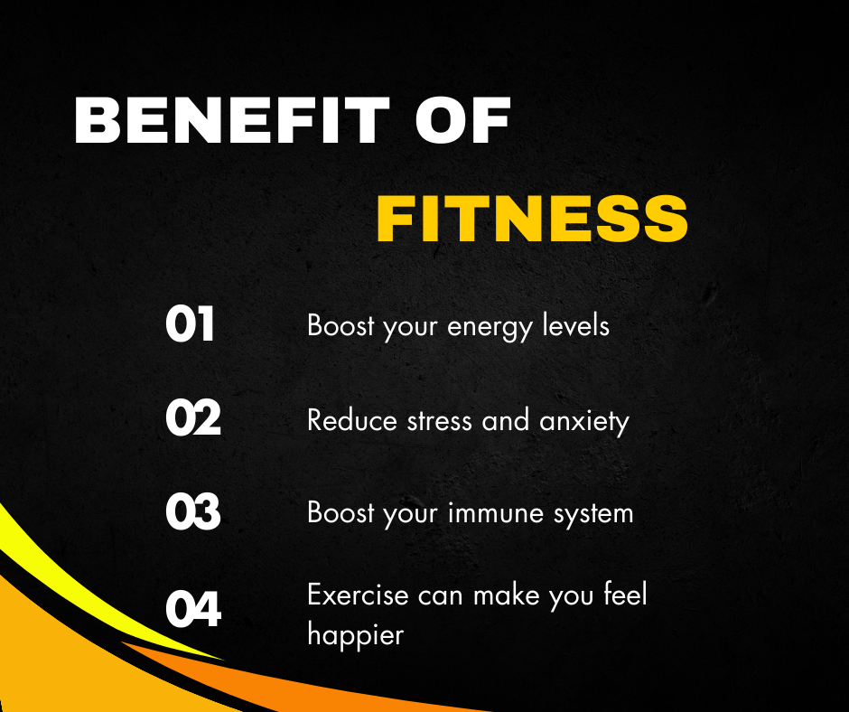

Slide 19
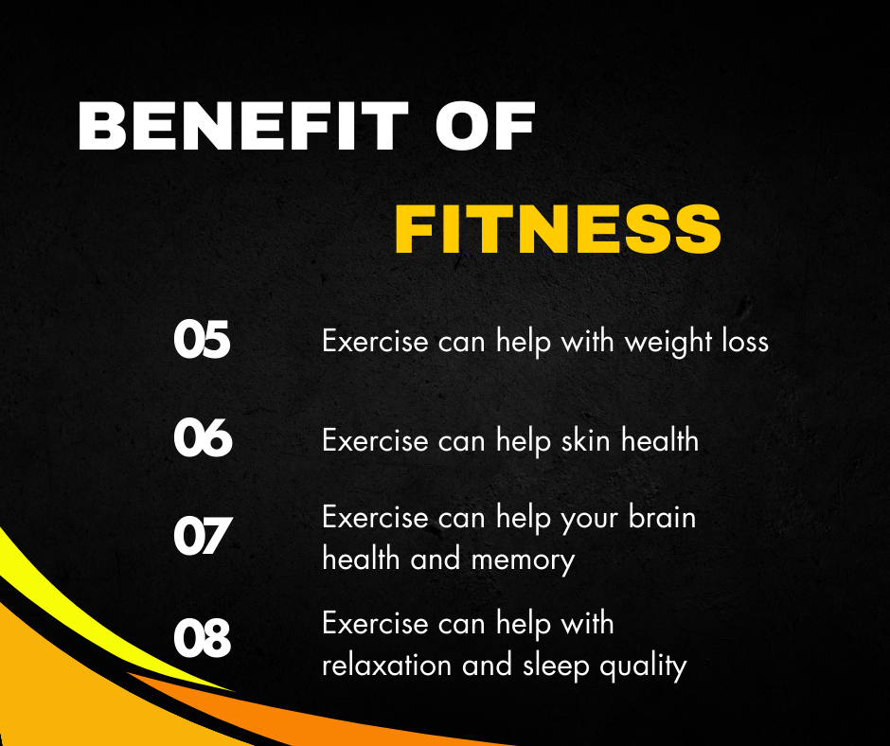

Slide 20



Dietary Goals
Dance and Fitness
Cha-Cha-Cha

Slide 21


Dietary Goals
Cha-Cha-Cha
01
Prioritize foods rich in complex carbohydrates, lean protein, and wholesome fats to maintain a consistent and enduring source of energy during active dance sessions.
02
Maintain continuous hydration to ensure agility, endurance, and peak performance while engaging in lively dance routines.
03
Consume a well-balanced meal abundant in carbohydrates and proteins a few hours prior to dancing, ensuring a sustained energy level without any feelings of discomfort.

Slide 22
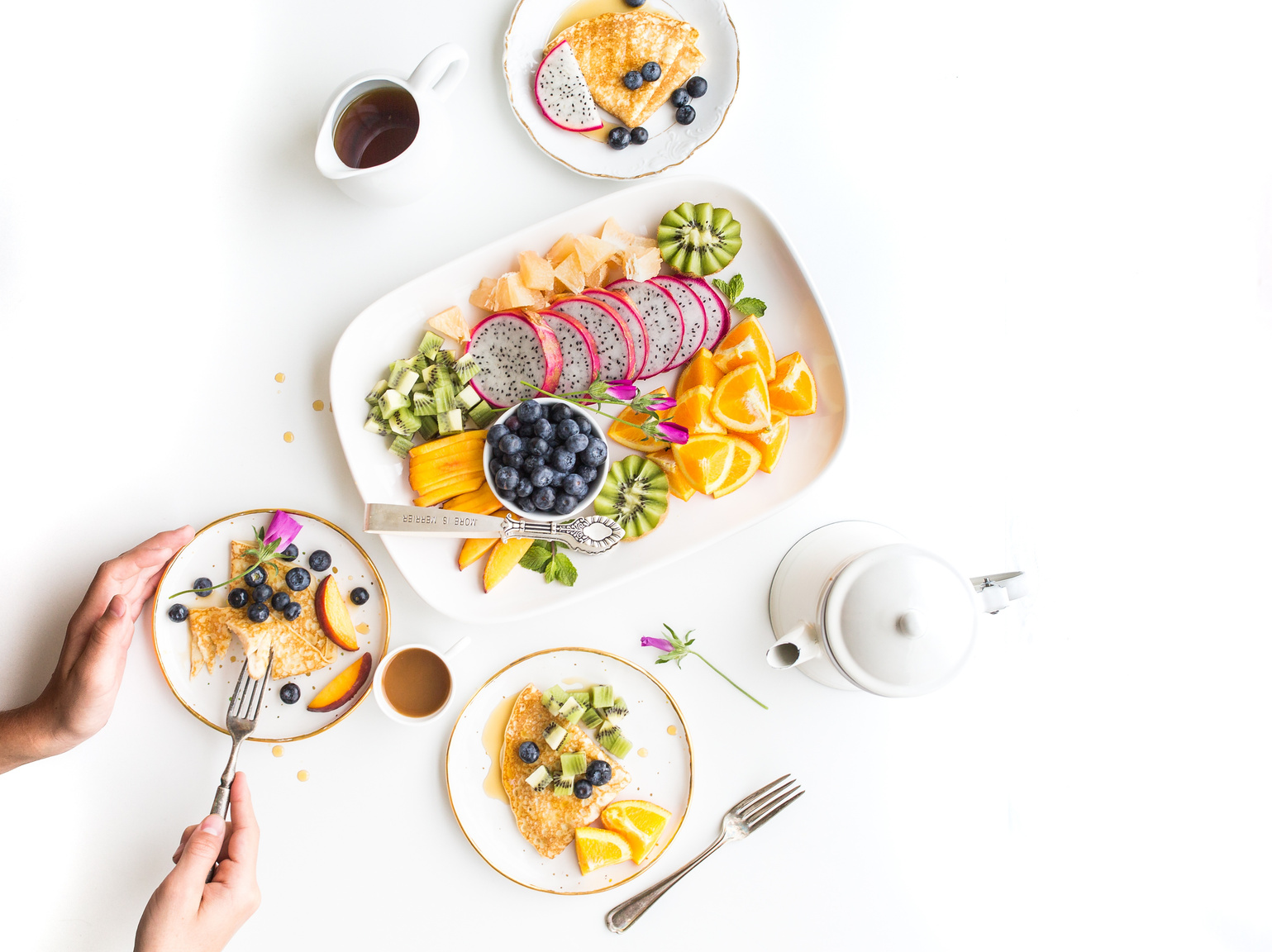
Dietary Goals
Cha-Cha-Cha
Pick a snacks after dancing that encompass both protein and carbohydrates, facilitating muscle recovery and replenishing depleted energy stores.
04
Look for nutrient-packed selections such as vibrant fruits, vegetables, lean proteins, and whole grains to bolster overall health and invigoration.
05
Enjoy treats in moderation and remain mindful of portion sizes to avert energy fluctuations during the course of dance events.
06

Slide 23
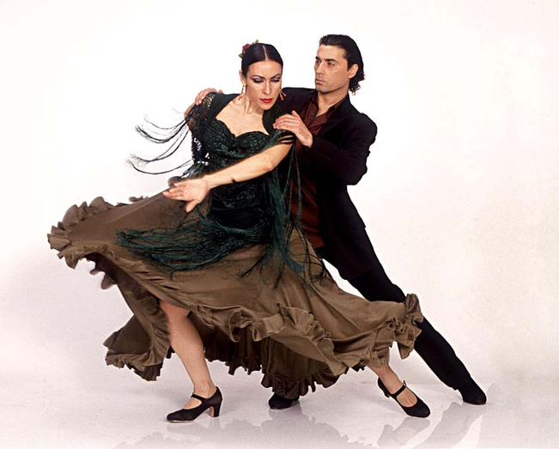
Dietary Goals
Cha-Cha-Cha
07
Look for easily digestible food choices to sidestep digestive discomfort and uphold the fluidity of dance movements.
08
Consume water consistently to safeguard hydration and counteract fluid loss resulting from spirited dance routines.
09
Pack convenient and well-balanced snacks combining carbohydrates and protein to sustain energy levels while taking breaks during dance sessions.
10
Aim for a comprehensive dietary regimen incorporating carbohydrates, proteins, and nourishing fats to bolster energy, stamina, and post-dance recovery.

